Slide 1
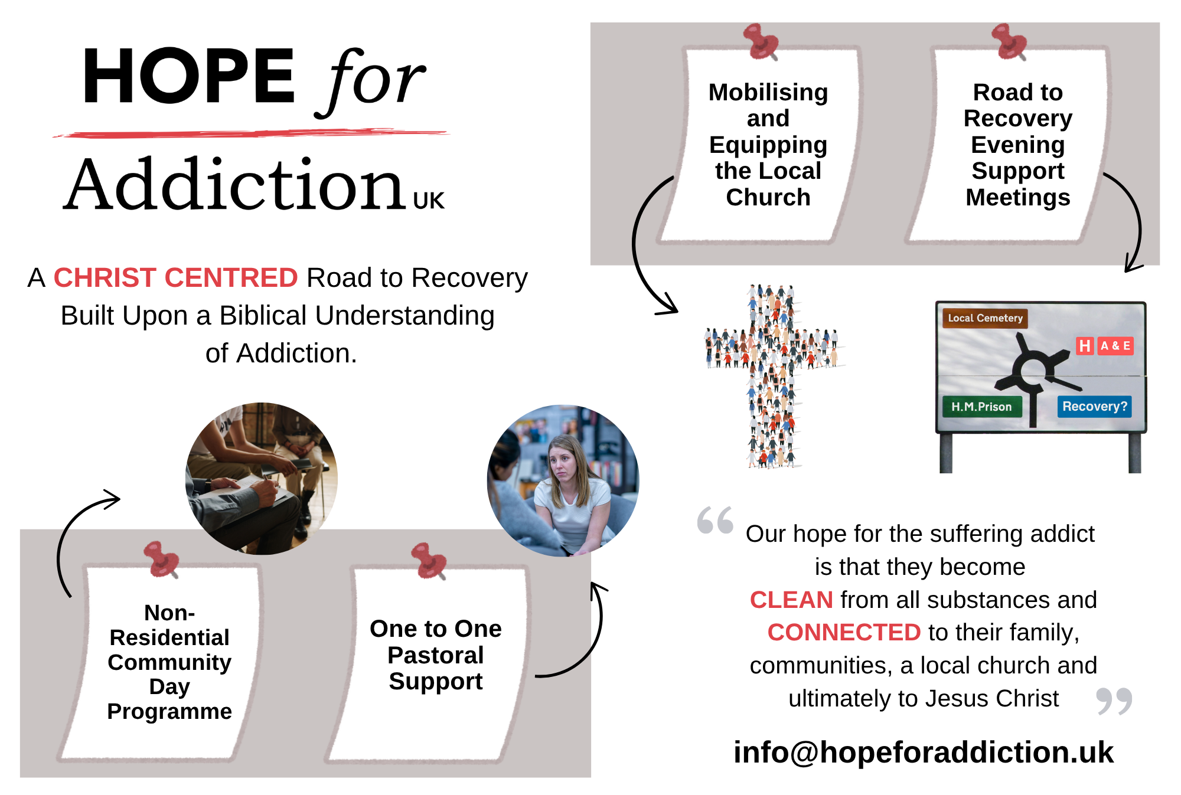

Slide 2

Clean & Connected.

Slide 3
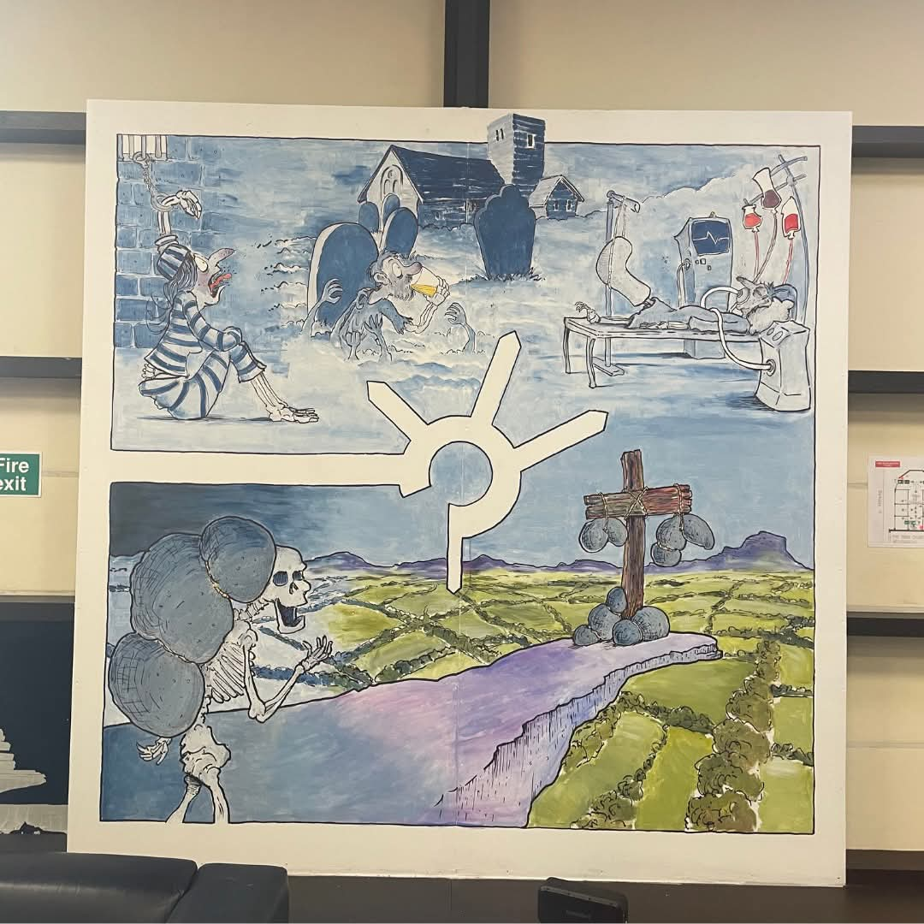
Lot’s Descent
‘If he rescued righteous Lot, greatly distressed by the sensual conduct of the wicked, (for as that righteous man lived among them day after day, he was tormenting his righteous soul over their lawless deeds that he saw and heard); then the Lord knows how to rescue the godly from trials.’
2 Peter 2:7-8

Slide 4
Lot’s Descent
‘Lot lifted up his eyes and saw that the Jordan Valley was well watered everywhere like the garden of the LORD, like the land of Egypt, in the direction of Zoar.’
Genesis 13:10

Slide 5
Lot’s Descent
‘Abram settled in the land of Canaan, while Lot lived among the cities of the valley and pitched his tent near Sodom.’
Genesis 13:12

Slide 6
Lot’s Descent
‘Lot was dwelling in Sodom.’
Genesis 14:12

Slide 7
Lot’s Descent
‘two angels came to Sodom in the evening, and Lot was sitting in the gate of Sodom.’
Genesis 19:1

Slide 8
Lot’s Descent
‘But he (Lot) lingered. So the men seized him and his wife and his two daughters by the hand, the Lord being merciful to him, and they brought him out and set him outside the city.’
Genesis 19:16

